Slide 1
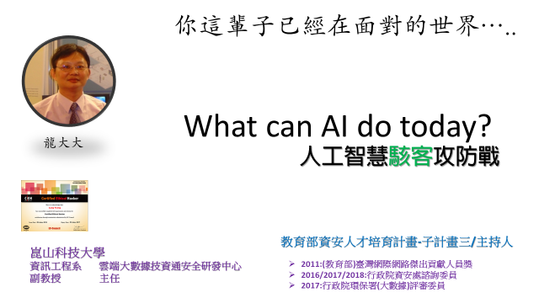
Deep Learning::CNN and RNN

Slide 2

MNIST handwritten digit
MNIST 手寫數字資料集
訓練集為 60,000 張 28x28 圖元灰度圖像，
測試集為 10,000 同規格圖像，
總共 10 類數字標籤。
MLP
CNN
RNN
GAN
使用Keras進行深度學習：（六）LSTM和雙向LSTM講解及實踐
2018年05月04日 18:38:29 磐創 AI
https://blog.csdn.net/fendouaini/article/details/80198994
Attention mechanism Implementation for Keras
https://github.com/philipperemy/keras-attention-mechanism

Slide 3
CNN神經網路架構

Slide 4
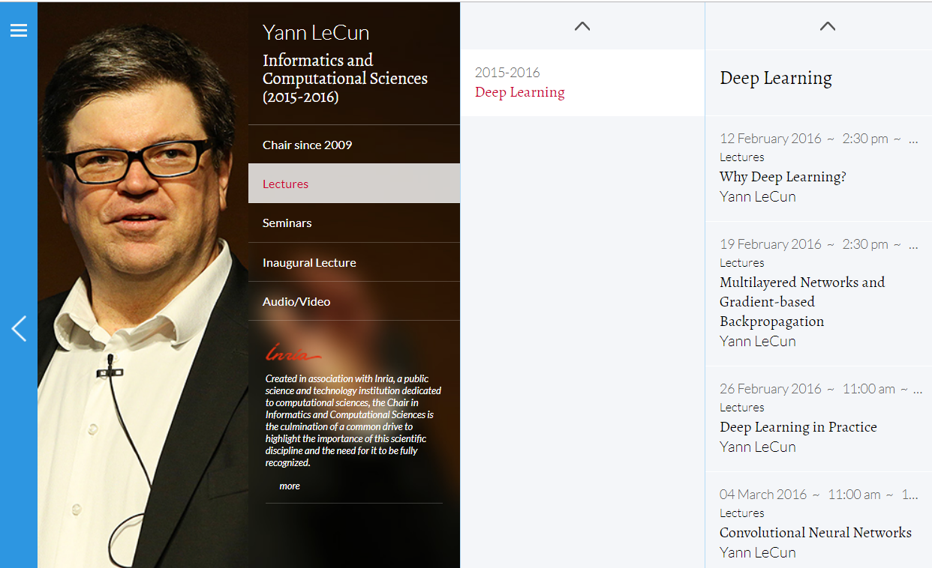
https://www.college-de-france.fr/site/en-yann-lecun/course-2015-2016.htm

Slide 5
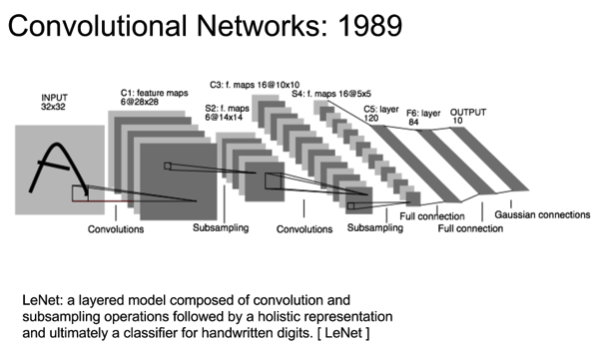

Slide 6
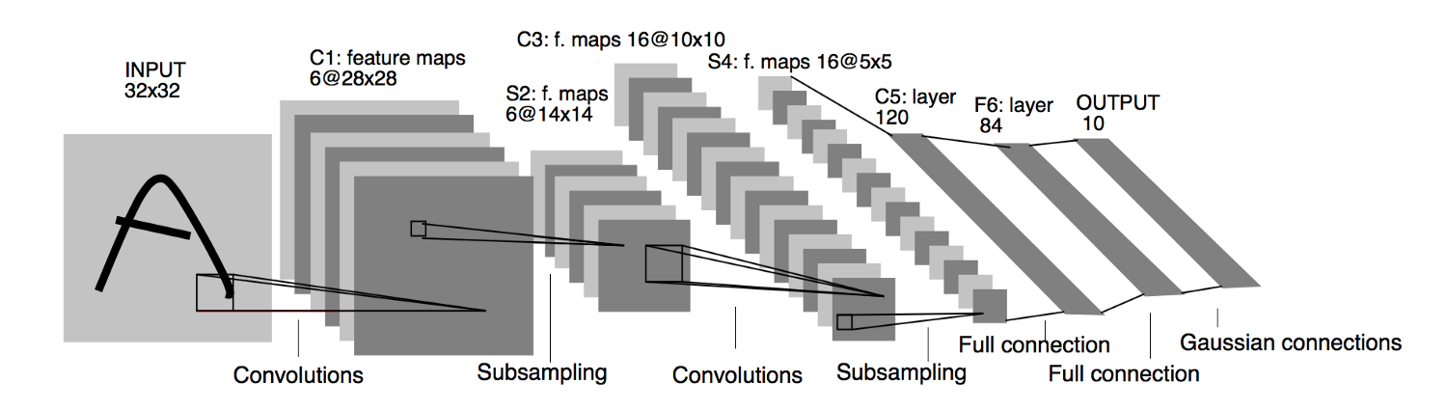

Slide 7
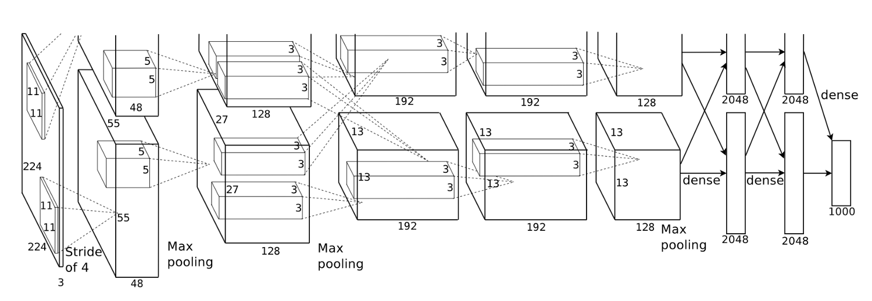
AlexNet(2012)::大突破
Hinton學生Alex Krizhevsky於2012年提出並拿下ILSVRC”12的冠軍讓CNN重返榮耀
其將top-5 error減少至15.3% ， outperform同年度第二名26.2%
LeNet5的加強版
主要的新技術與應用::將ReLU, Dropout, LRN加到model中
用GPU來加快training效率
data augmentation增加訓練資料集

Slide 8
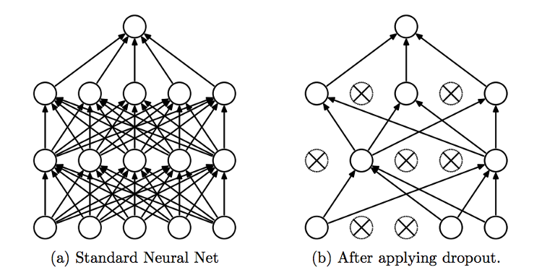
Dropout
在訓練過程中隨機地將某些connection拔掉，可有效降低overfitting的問題

Slide 9
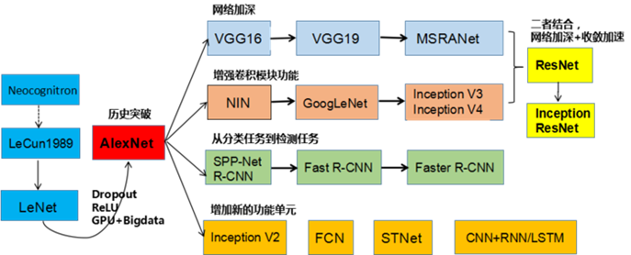
https://medium.com/@rgnuj122/lenet%E6%89%8B%E6%8A%8A%E6%89%8B%E5%AF%A6%E4%BD%9C%E6%95%99%E5%AD%B8-1c2f149c822f

Slide 10
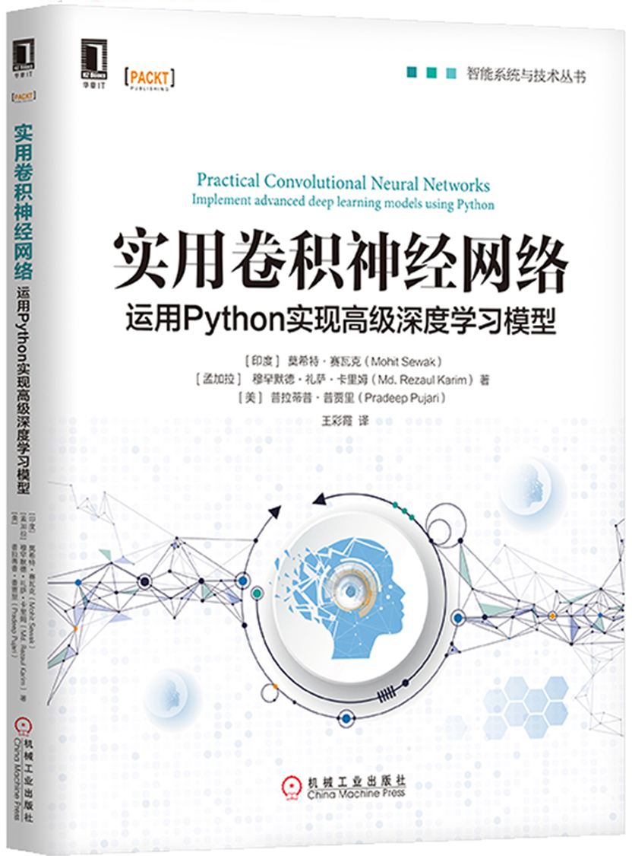
第5章 轉移學習 103
5.1 特徵提取方法 103
5.1.1 目標資料集較小且與原始訓練集相似 104
5.1.2 目標資料集較小且與原始訓練集不同 105
5.1.3 目標資料集很大且與原始訓練集相似 107
5.1.4 目標資料集很大且與原始訓練集不同 107
5.2 轉移學習示例 108
5.3 多工學習 111
第6章 CNN自編碼器 113
6.1 自編碼器介紹 113
6.2 卷積自編碼器 114
6.3 應用 115
第7章 CNN目標檢測與實例分割 119
7.1 目標檢測與圖像分類的區別 120
7.2 傳統的、非CNN的目標檢測方法 124
7.3 R-CNN：CNN特徵區 128
7.4 Fast R-CNN：基於區域快速識別的CNN 130
7.5 Faster R-CNN：基於快速區域生成網路的CNN 132
7.6 Mask R-CNN：CNN實例分割 135
7.7 實例分割的代碼實現 137
7.7.1 創建環境 138
7.7.2 準備COCO資料集資料夾結構 139
7.7.3 在COCO資料集上運行預訓練模型 139
第4章 經典的CNN模型架構 91
4.1 ImageNet介紹 91
4.2 LeNet 92
4.3 AlexNet架構 93
4.4 VGGNet架構 95
4.5 GoogLeNet架構 97
4.5.1 架構洞察 98
4.5.2 inception模組 99
4.6 ResNet架構 99

Slide 11
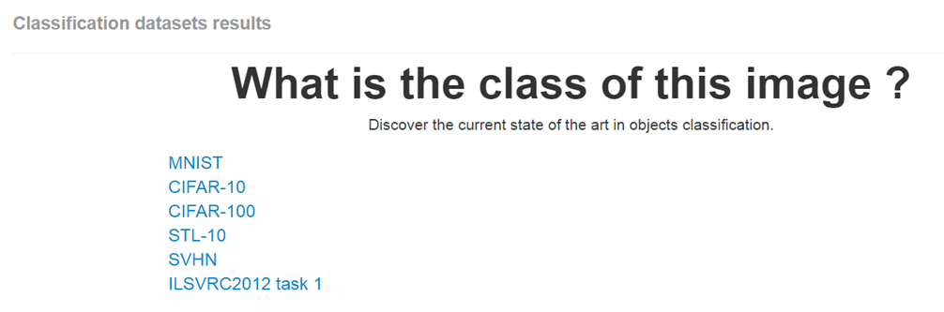
What is the class of this image ?
http://rodrigob.github.io/are_we_there_yet/build/classification_datasets_results.html#4d4e495354

Slide 12
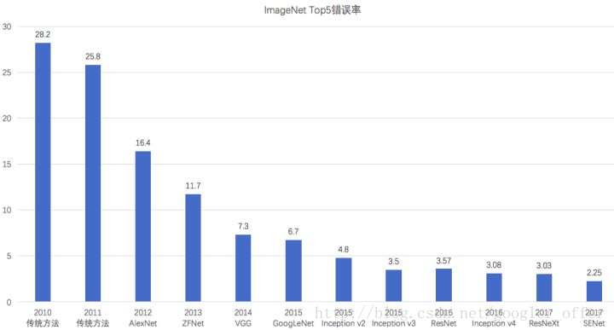
ImageNet上的分類錯誤率逐年降低
且已經低於人類的錯誤率（5.1%）

Slide 13
SENet::Squeeze-and-Excitation Networks(2017-2019)
https://arxiv.org/abs/1709.01507
Caffe實作
https://github.com/hujie-frank/SENet
The central building block of convolutional neural networks (CNNs) is the convolution operator, which enables networks to construct informative features by fusing both spatial and channel-wise information within local receptive fields at each layer.
A broad range of prior research has investigated the spatial component of this relationship, seeking to strengthen the representational power of a CNN by enhancing the quality of spatial encodings throughout its feature hierarchy.
In this work, we focus instead on the channel relationship and propose a novel architectural unit, which we term the "Squeeze-and-Excitation" (SE) block, that adaptively recalibrates channel-wise feature responses by explicitly modelling interdependencies between channels. We show that these blocks can be stacked together to form SENet architectures that generalise extremely effectively across different datasets. We further demonstrate that SE blocks bring significant improvements in performance for existing state-of-the-art CNNs at slight additional computational cost. Squeeze-and-Excitation Networks formed the foundation of our ILSVRC 2017 classification submission which won first place and reduced the top-5 error to 2.251%, surpassing the winning entry of 2016 by a relative improvement of ~25%. Models and code are available at this https URL.

Slide 14
Tensorflow 實作
https://github.com/taki0112/SENet-Tensorflow
PyTorch 實作
https://github.com/moskomule/senet.pytorch
Keras 實作
https://github.com/titu1994/keras-squeeze-excite-network
https://github.com/yoheikikuta/senet-keras
說明文件
https://blog.csdn.net/u014380165/article/details/78006626
keras瞎搞系列-從LeNet到SENet——卷積神經網路回顧
https://blog.csdn.net/googler_offer/article/details/79478893

Slide 15
CNN應用

Slide 16
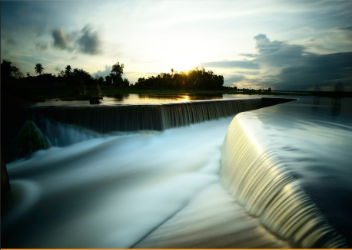

Stylenet / Neural-Style(2015)
A Neural Algorithm of Artistic Style
Leon A. Gatys, Alexander S. Ecker, Matthias Bethge
(Submitted on 26 Aug 2015 (v1), last revised 2 Sep 2015 (this version, v2))
https://arxiv.org/abs/1508.06576
style image
風格
塞尚

Slide 17
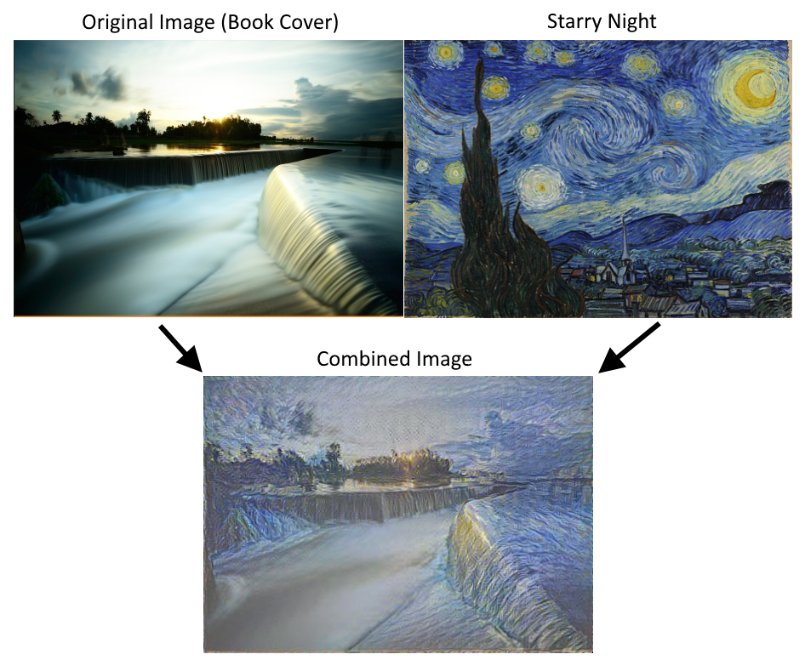

Slide 18
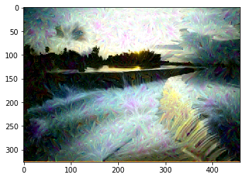
Deep Dream
Convolutional Neural Network image generation
https://github.com/nfmcclure/tensorflow_cookbook/blob/master/08_Convolutional_Neural_Networks/06_Deepdream/06_deepdream.ipynb

Slide 19
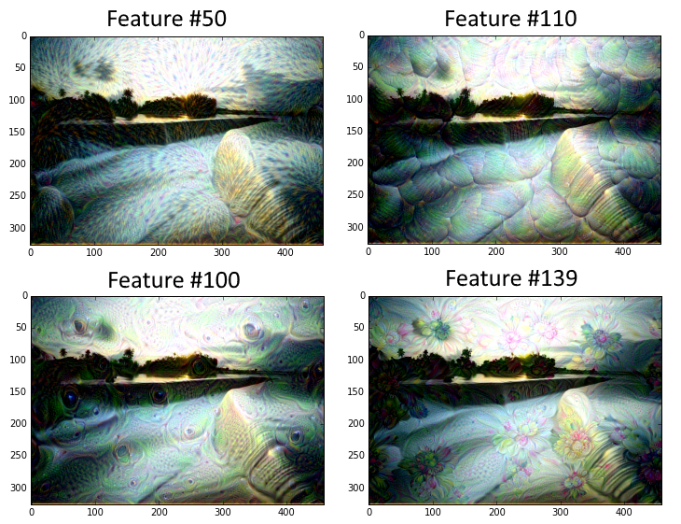

Slide 20
CNN核心運算

Slide 21
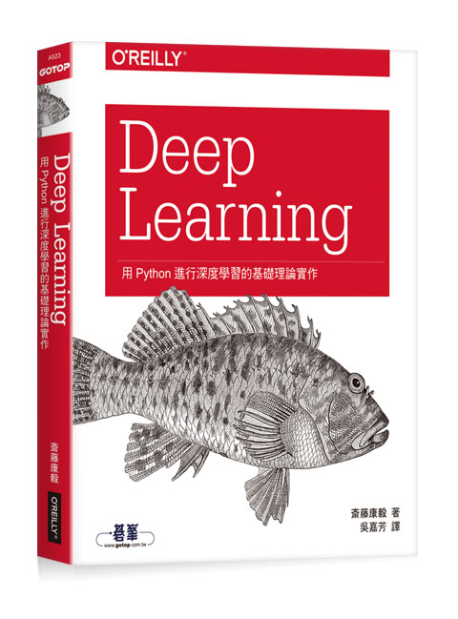
Deep Learning：用Python進行深度學習的基礎理論實作
作者： 斎藤康毅 譯者： 吳嘉芳
出版社：歐萊禮 出版日期：2017/08/17
好書推薦
第一章 Python入門
第二章 感知器
第三章 神經網路
第四章 神經網路的學習
第五章 誤差反向傳播法
第六章 與學習有關的技巧
第七章 卷積神經網路
第八章 深度學習
附錄A Softmax-with-Loss層的計算圖
參考文獻
https://github.com/oreilly-japan/deep-learning-from-scratch

Slide 22
Fully connected Neural Network::使用全連結層
Convolutional Neural Network::增加不同結構的神經網路結構
Convolution卷積運算(層)
Pooling::池化運算(層)

Slide 23
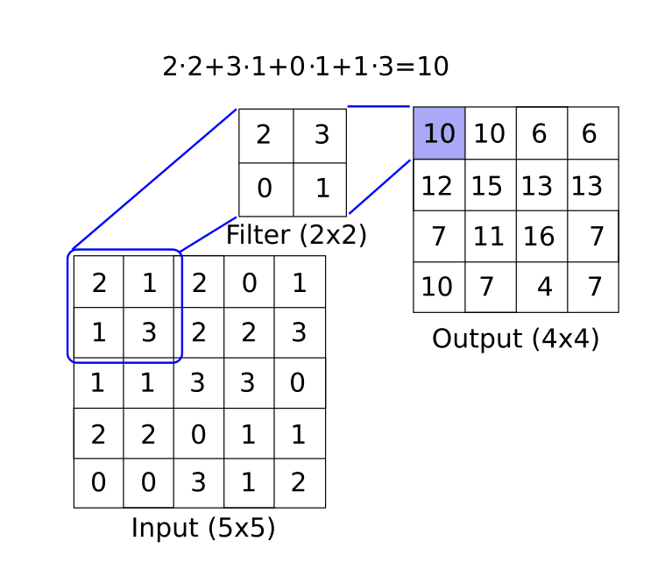
Convolution運算

Slide 24
Convolution運算

Slide 25
Convolution運算:padding(填補)

Slide 26
Convolution運算:stride(步幅)

Slide 27
Convolution運算:stride(步幅)

Slide 28
https://www.tensorflow.org/api_docs/python/tf/nn/conv2d
tf.nn.conv2d(
input,
filter,
strides,
padding,
use_cudnn_on_gpu=True,
data_format='NHWC',
dilations=[1, 1, 1, 1],
name=None
)
"SAME",
"VALID"
padding: A string from: "SAME", "VALID". The type of padding algorithm to use

Slide 29
padding: "SAME"

Slide 30
padding: "VALID"

Slide 31
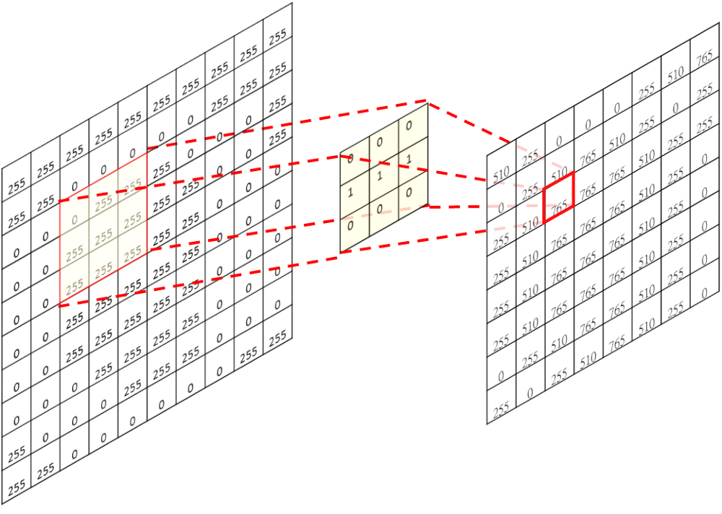
卷積神經網路(Convolutional neural network, CNN) — 卷積運算、池化運算
Tommy Huang
https://medium.com/@chih.sheng.huang821/%E5%8D%B7%E7%A9%8D%E7%A5%9E%E7%B6%93%E7%B6%B2%E8%B7%AF-convolutional-neural-network-cnn-%E5%8D%B7%E7%A9%8D%E9%81%8B%E7%AE%97-%E6%B1%A0%E5%8C%96%E9%81%8B%E7%AE%97-856330c2b703

Slide 32
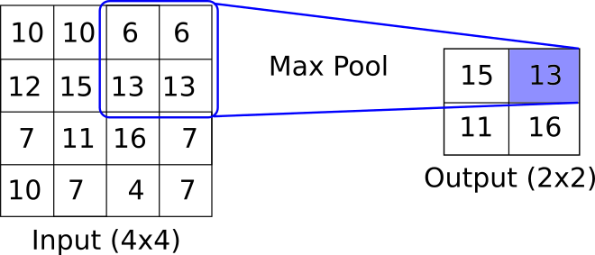
MaxPooling運算
圖的大小很容易因為pooling變得很小，2x2的Pooling會讓圖小一半，3x3的pooling小3分之1。
跟卷積運算一樣，Pooling也可以用zero padding和strides的方式，讓圖不要一次變太小。

Slide 33
CNN特色

Slide 34
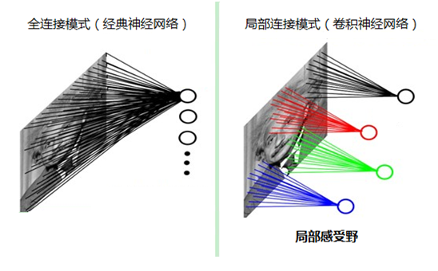
CNN的幾個特點： 局部感知、參數共用、池化
https://my.oschina.net/u/876354/blog/1632862

Slide 35
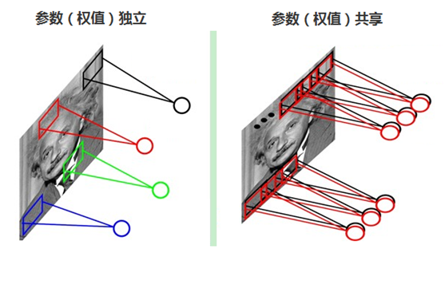
CNN的幾個特點： 局部感知、參數共用、池化
每張自然圖像（人物、山水、建築等）都有其固有特性，也就是說，圖像其中一部分的統計特性與其它部分是接近的。
這也意味著這一部分學習的特徵也能用在另一部分上，能使用同樣的學習特徵。
因此，在局部連接中隱藏層的每一個神經元連接的局部圖像的權值參數（例如5×5），將這些權值參數共用給其它剩下的神經元使用，那麼此時不管隱藏層有多少個神經元，需要訓練的參數就是這個局部圖像的許可權參數（例如5×5），也就是卷積核的大小，這樣大大減少了訓練參數

Slide 36
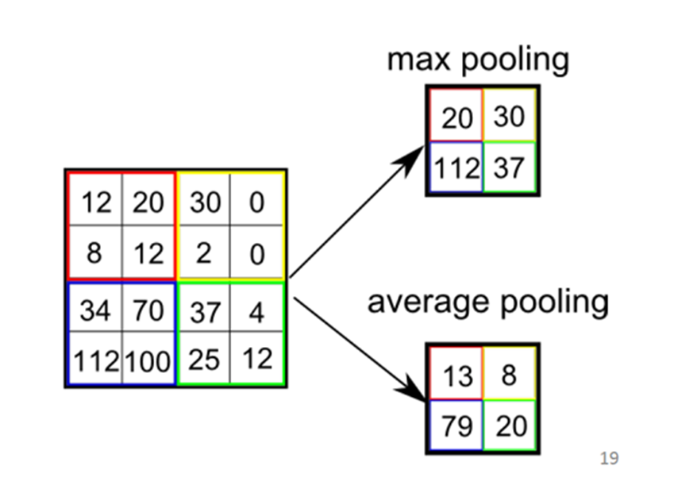
CNN的幾個特點： 局部感知、參數共用、池化
隨著模型網路不斷加深，卷積核越來越多，要訓練的參數還是很多，而且直接拿卷積核提取的特徵直接訓練也容易出現過擬合的現象。
對圖像使用卷積提取特徵是因為圖像具有一種“靜態性”的屬性，因此，一個很自然的想法就是對不同位置區域提取出有代表性的特徵（進行聚合統計，例如最大值、平均值等），這種聚合的操作就叫做池化，
池化的過程通常也被稱為特徵映射的過程（特徵降維）

Slide 37
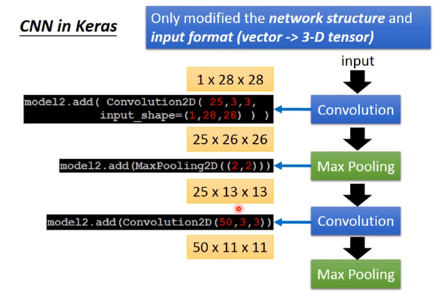
ML Lecture 10: Convolutional Neural Network
https://www.youtube.com/watch?v=FrKWiRv254g

Slide 38
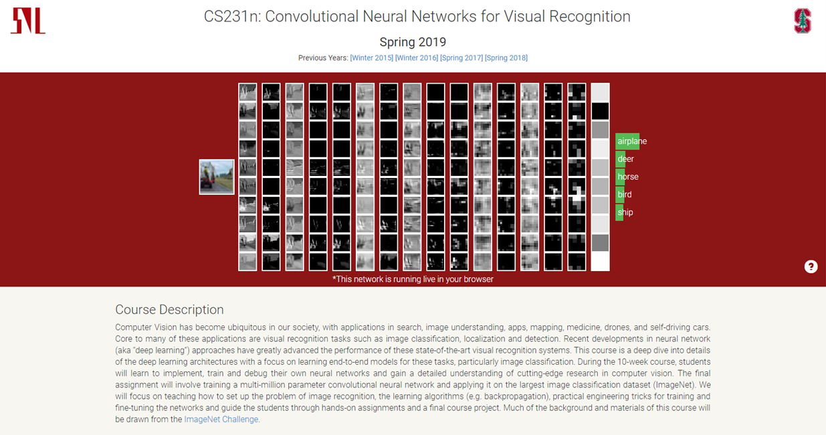
http://cs231n.stanford.edu/
CS231n: Convolutional Neural Networks for Visual Recognition
Spring 2019

Slide 39
Keras
CNN::MNIST

Slide 40
Coding……..
Tensorflow::CNN_MNIST
TF_CNN_MNIST.ipynb
Keras::CNN_MNIST
Keras_CNN_MNIST_Good.ipynb

Slide 41
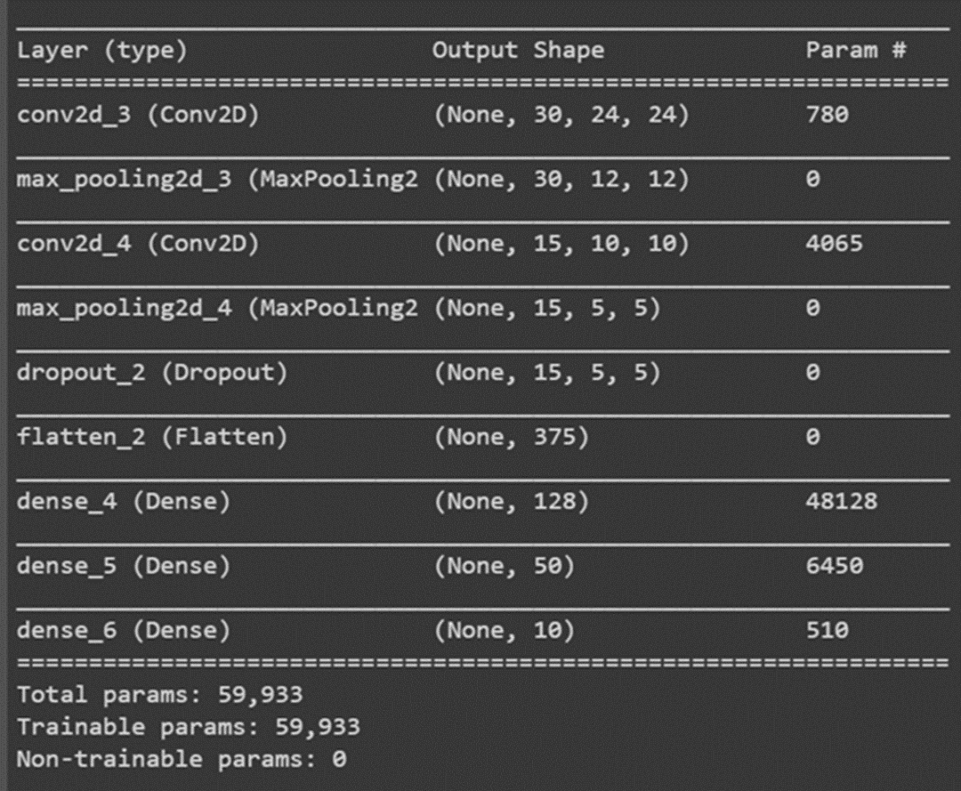
AI4high/Keras_CNN_MNIST_Good.ipynb
13.5 複雜卷積神經網路/120

Slide 42
13.5 複雜卷積神經網路/120
from keras.datasets import mnist
import numpy as np
from keras.models import Sequential
from keras.layers import Dense
from keras.layers import Dropout
from keras.layers import Flatten
from keras.layers.convolutional import Conv2D
from keras.layers.convolutional import MaxPooling2D
from keras.utils import np_utils
from keras import backend
backend.set_image_data_format('channels_first')
# 設定隨機種子
seed = 7
np.random.seed(seed)

Slide 43
# 從Keras導入Mnist資料集
(X_train, y_train), (X_validation, y_validation) = mnist.load_data()
X_train = X_train.reshape(X_train.shape[0], 1, 28, 28).astype('float32')
X_validation = X_validation.reshape(X_validation.shape[0], 1, 28, 28).astype('float32')
# 格式化資料到0-1之前
X_train = X_train / 255
X_validation = X_validation / 255
# one-hot編碼
y_train = np_utils.to_categorical(y_train)
y_validation = np_utils.to_categorical(y_validation)

Slide 44
# 創建模型
def create_model():
model = Sequential()
model.add(Conv2D(30, (5, 5), input_shape=(1, 28, 28), activation='relu'))
model.add(MaxPooling2D(pool_size=(2, 2)))
model.add(Conv2D(15, (3, 3), activation='relu'))
model.add(MaxPooling2D(pool_size=(2, 2)))
model.add(Dropout(0.2))
model.add(Flatten())
model.add(Dense(units=128, activation='relu'))
model.add(Dense(units=50, activation='relu'))
model.add(Dense(units=10, activation='softmax'))
# 編譯模型
model.compile(loss='categorical_crossentropy', optimizer='adam', metrics=['accuracy'])
return model

Slide 45
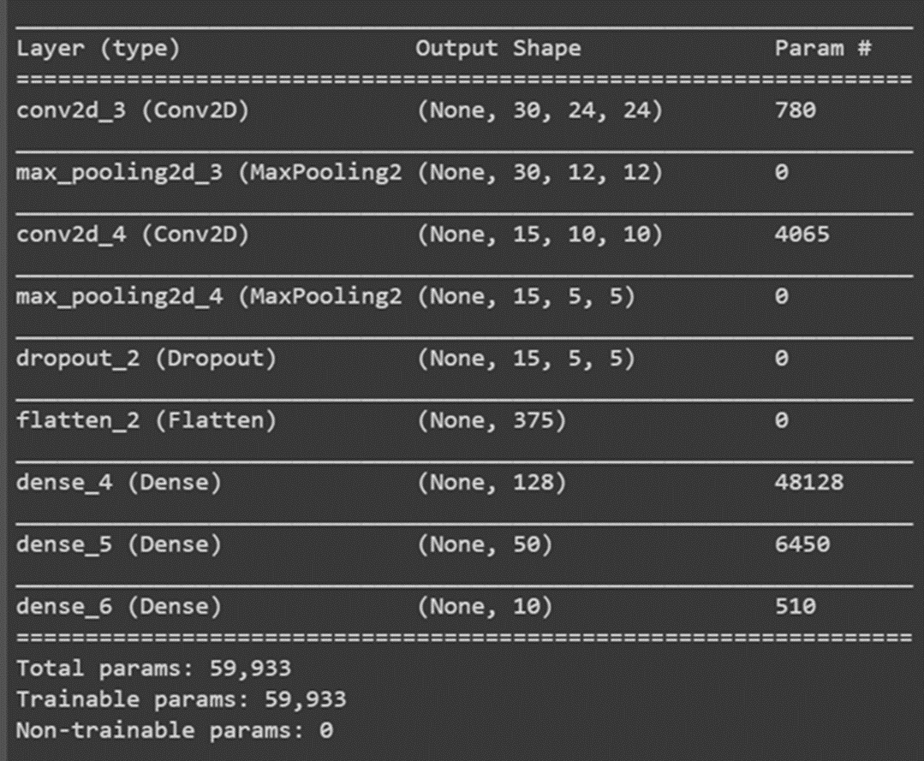
# 創建模型
def create_model():
model = Sequential()
model.add(Conv2D(30, (5, 5), input_shape=(1, 28, 28), activation='relu'))
model.add(MaxPooling2D(pool_size=(2, 2)))
model.add(Conv2D(15, (3, 3), activation='relu'))
model.add(MaxPooling2D(pool_size=(2, 2)))
model.add(Dropout(0.2))
model.add(Flatten())
model.add(Dense(units=128, activation='relu'))
model.add(Dense(units=50, activation='relu'))
model.add(Dense(units=10, activation='softmax'))

Slide 46
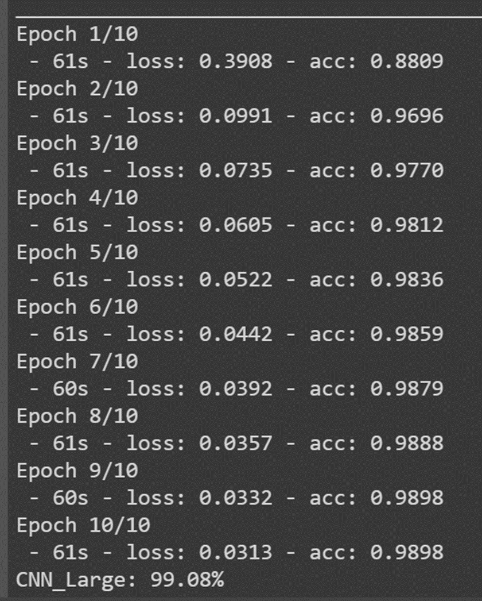
model = create_model()
model.summary()
model.fit(X_train, y_train, epochs=10, batch_size=200, verbose=2)
score = model.evaluate(X_validation, y_validation, verbose=0)
print('CNN_Large: %.2f%%' % (score[1] * 100))

Slide 47
model = create_model()
model.summary()

Slide 48
RNN

Slide 49
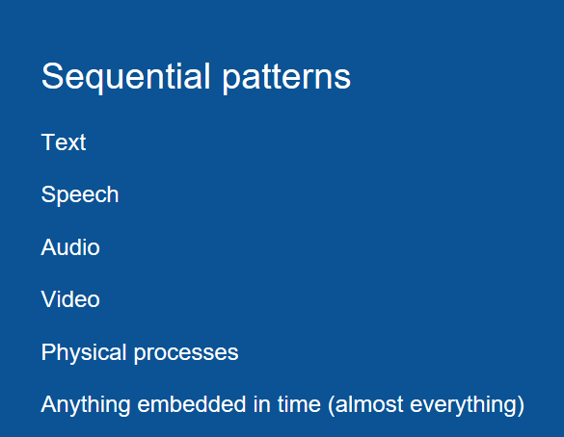
RNN for…..
https://brohrer.mcknote.com/zh-Hant/how_machine_learning_works/how_rnns_lstm_work.html

Slide 50

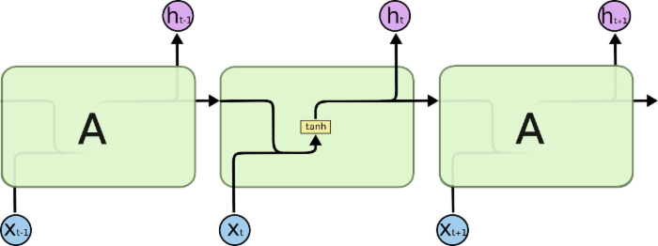
SimpleRNN

Slide 51

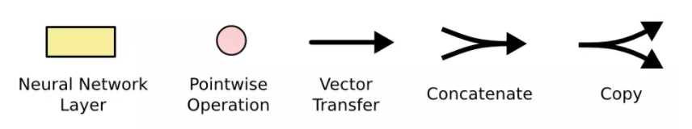
LSTM
https://brohrer.mcknote.com/zh-Hant/how_machine_learning_works/how_rnns_lstm_work.html
https://blog.csdn.net/fendouaini/article/details/80198994

Slide 52
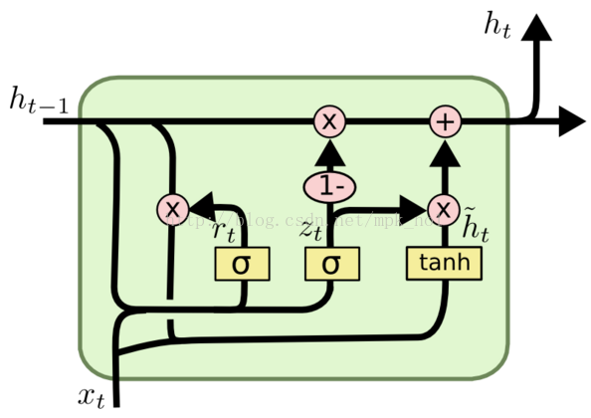
GRU
https://blog.csdn.net/mpk_no1/article/details/72875185

Slide 53
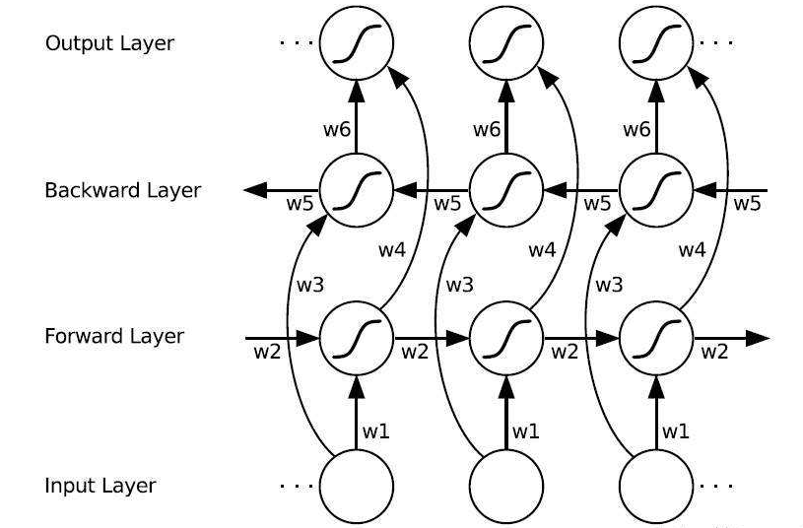
雙向LSTM(Bi-directional LSTM)
https://blog.csdn.net/fendouaini/article/details/80198994

Slide 54
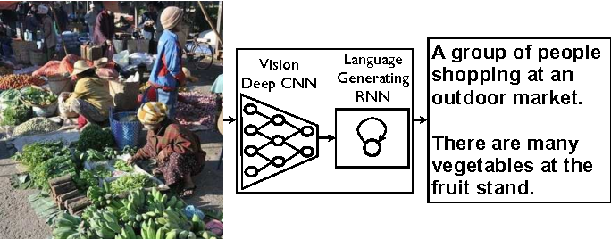
Show and tell: A neural image caption generator(2015)
https://arxiv.org/abs/1411.4555
https://www.semanticscholar.org/paper/Show-and-tell%3A-A-neural-image-caption-generator-Vinyals-Toshev/11da2d589485685f792a8ac79d4c2e589e5f77bd
看圖說話——CNN和LSTM的聯合應用
2018年01月21日 00:37:12 張雨石
https://blog.csdn.net/stdcoutzyx/article/details/79117869

Slide 55
會話機器人[智慧客服，聊天機器人]
Rasa https://rasa.com/docs/
Google Dialogflow https://dialogflow.com/docs/getting-started
Microsoft LUIS https://www.luis.ai/home
Facebook Wit.ai https://wit.ai/docs
Amazon Lex https://aws.amazon.com/lex/

Slide 56
Coding……..
3_2_Keras_Mnist_RNN.ipynb

Slide 57
AI and Security 人工智慧與資訊安全

Slide 58



現代資安情境:從工人智慧到人工智慧
人工智慧強化的資安
人工智慧強化的攻擊
攻擊人工智慧系統
+演算法

Slide 59
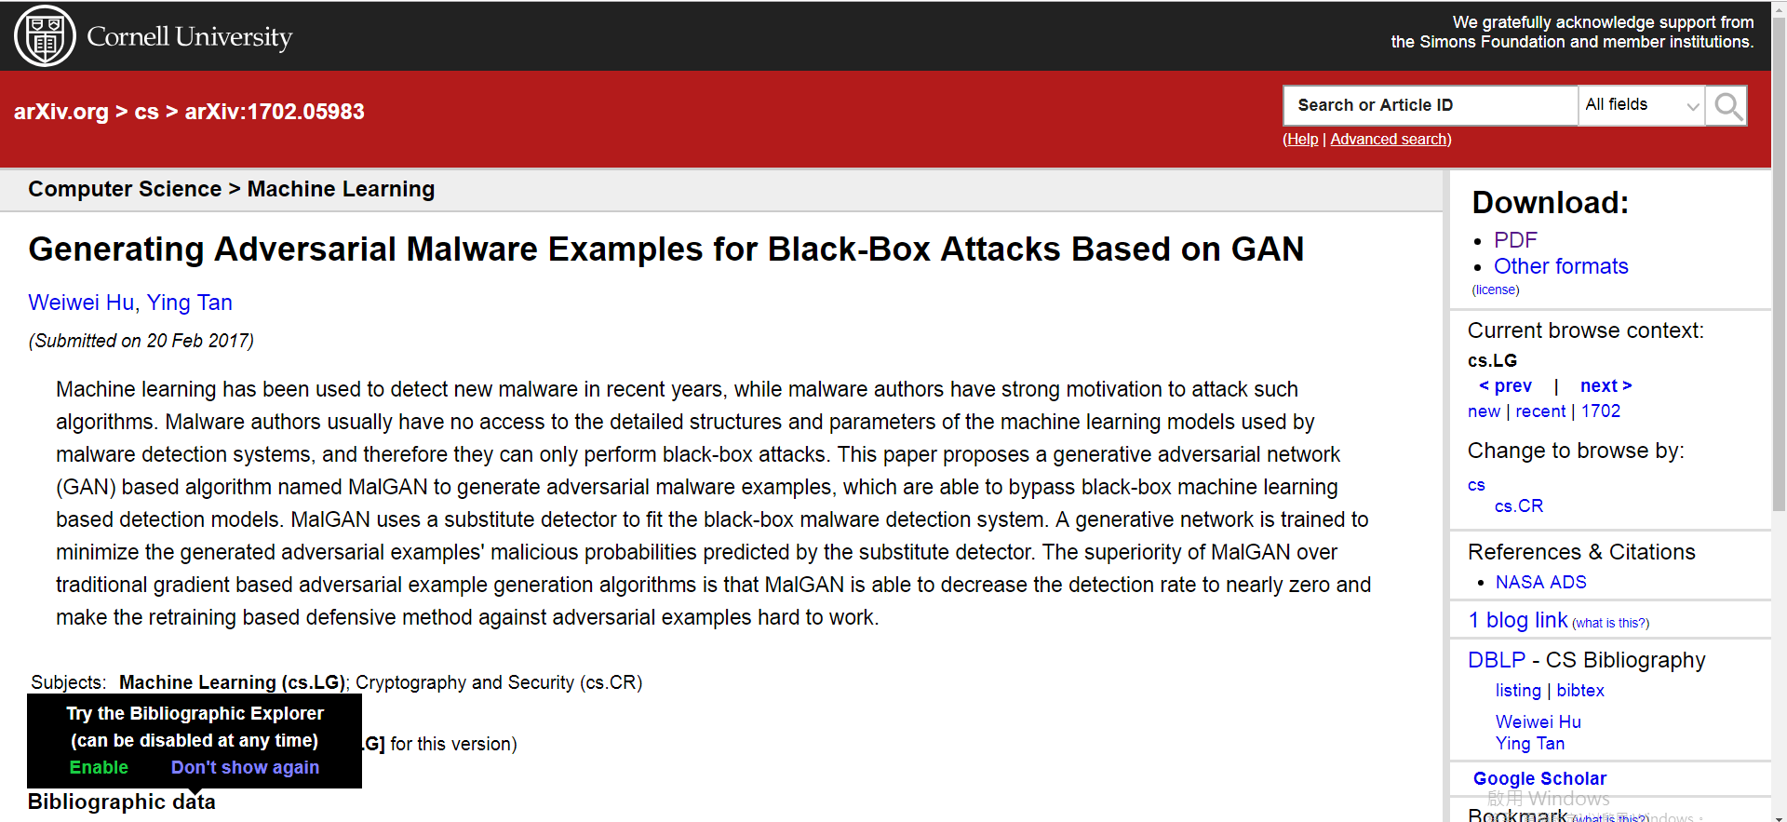
AI強化的攻擊手法
MalGAN :Generating Adversarial Malware Examples for Black-Box Attacks Based on GAN
https://arxiv.org/abs/1702.05983

Slide 60
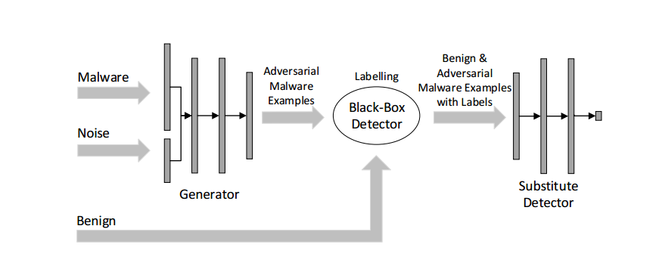
MalGAN
Generating Adversarial Malware Examples for Black-Box Attacks Based on GAN" 2017 https://arxiv.org/abs/1702.05983
https://github.com/yanminglai/Malware-GAN
Malware-GAN

Slide 61
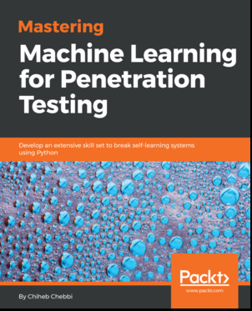

Mastering Machine Learning for Penetration Testing
Chiheb Chebbi
June 2018
AI強化的偵測手法
1: INTRODUCTION TO MACHINE LEARNING IN PENTESTING
2: PHISHING DOMAIN DETECTION
3: MALWARE DETECTION WITH API CALLS AND PE HEADERS
4: MALWARE DETECTION WITH DEEP LEARNING
5: BOTNET DETECTION WITH MACHINE LEARNING
6: MACHINE LEARNING IN ANOMALY DETECTION SYSTEMS
7: DETECTING ADVANCED PERSISTENT THREATS(APT攻擊)
8: EVADING INTRUSION DETECTION SYSTEMS
9: BYPASSING MACHINE LEARNING MALWARE DETECTORS
10: BEST PRACTICES FOR MACHINE LEARNING AND FEATURE ENGINEERING
CleverHans, a Python library to benchmark machine learning systems' vulnerability to adversarial examples.
https://github.com/tensorflow/cleverhans
https://github.com/PacktPublishing/Mastering-Machine-Learning-for-Penetration-Testing

Slide 62
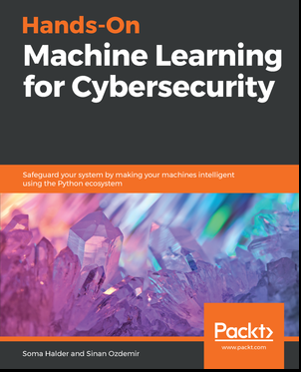
1: BASICS OF MACHINE LEARNING IN CYBERSECURITY
2: TIME SERIES ANALYSIS AND ENSEMBLE MODELING
3: SEGREGATING LEGITIMATE AND LOUSY URLS
4: KNOCKING DOWN CAPTCHAS
5: USING DATA SCIENCE TO CATCH EMAIL FRAUD AND SPAM
6: EFFICIENT NETWORK ANOMALY DETECTION USING K-MEANS
7: DECISION TREE AND CONTEXT-BASED MALICIOUS EVENT DETECTION
8: CATCHING IMPERSONATORS AND HACKERS RED HANDED
9: CHANGING THE GAME WITH TENSORFLOW
10: FINANCIAL FRAUD AND HOW DEEP LEARNING CAN MITIGATE IT
11: CASE STUDIES

Slide 63
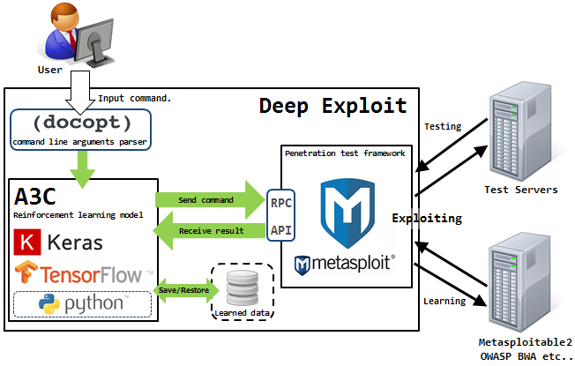
Deep Exploit:
Fully automatic penetration test tool using Machine Learning
AI and Security
自動化滲透測試
https://securityonline.info/deep-exploit/
https://github.com/13o-bbr-bbq/machine_learning_security/tree/master/DeepExploit

Slide 64
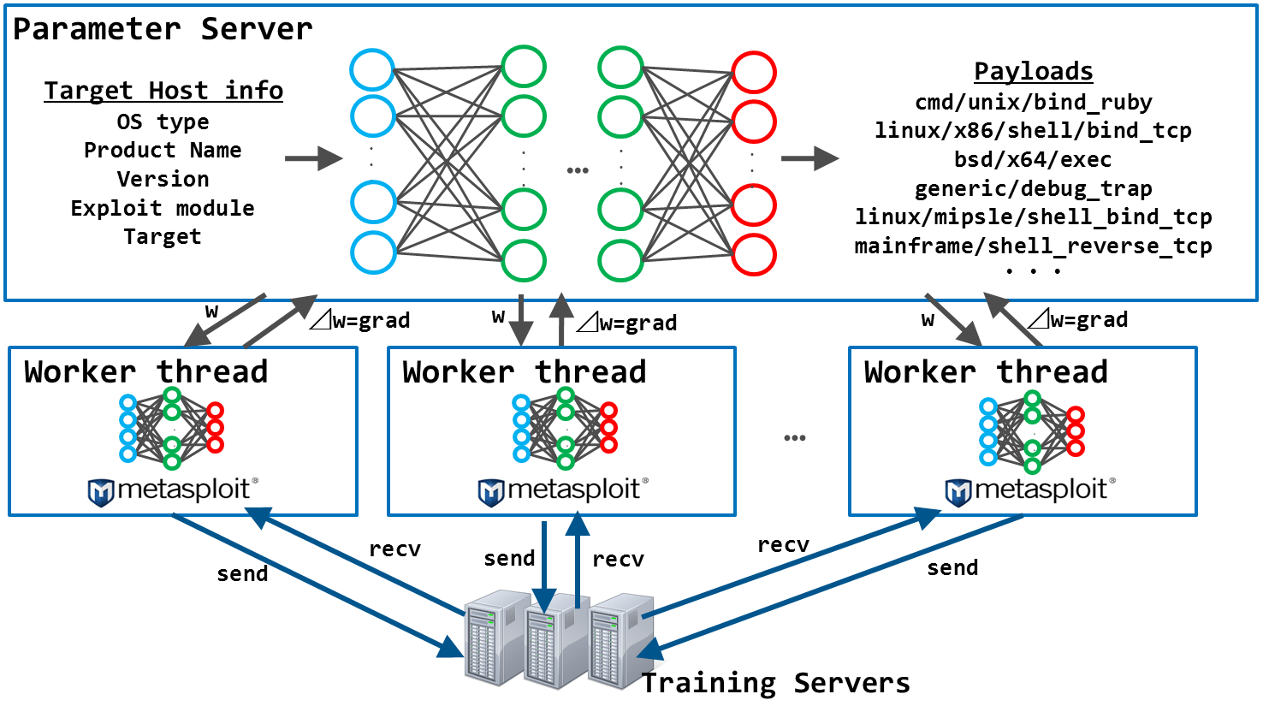

Slide 65


GyoiThon: Penetration Testing Using Machine Learning
https://github.com/gyoisamurai/GyoiThon
https://github.com/gyoisamurai/GyoiThon/blob/master/handout/BHASIA2019_slide.pdf

Slide 66
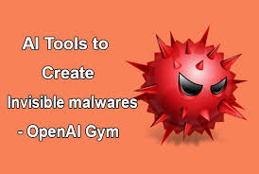
攻擊人工智慧系統+演算法
YOUTUBE影片:https://www.youtube.com/watch?v=_7oJZLjnGwQ
https://paper.seebug.org/papers/Security%20Conf/Blackhat/2017_us/us-17-Anderson-Bot-Vs-Bot-Evading-Machine-Learning-Malware-Detection-wp.pdf
https://github.com/endgameinc/gym-malware

Slide 67

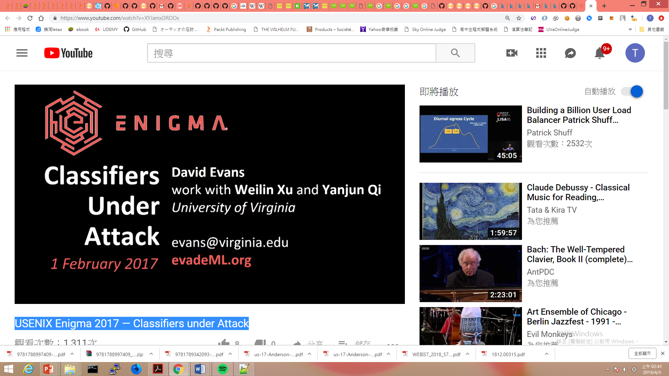
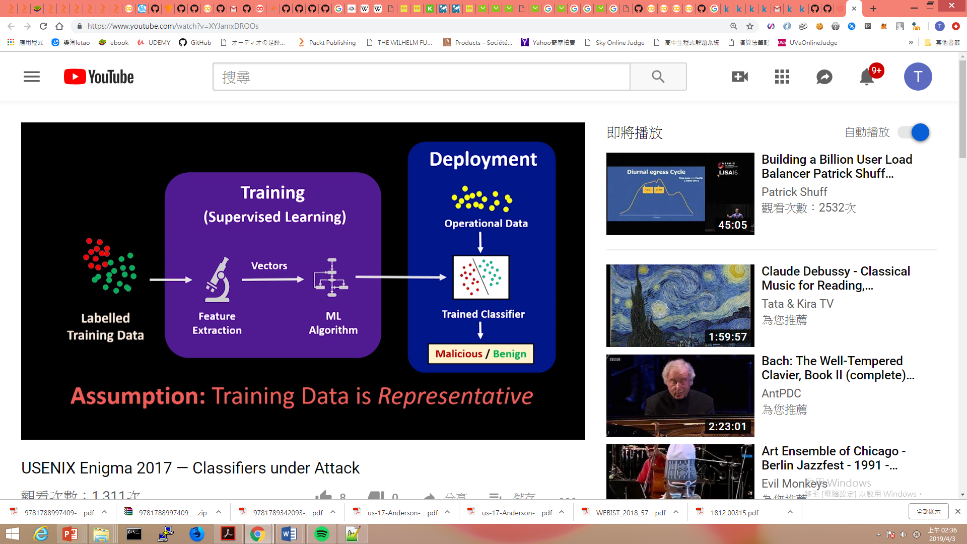
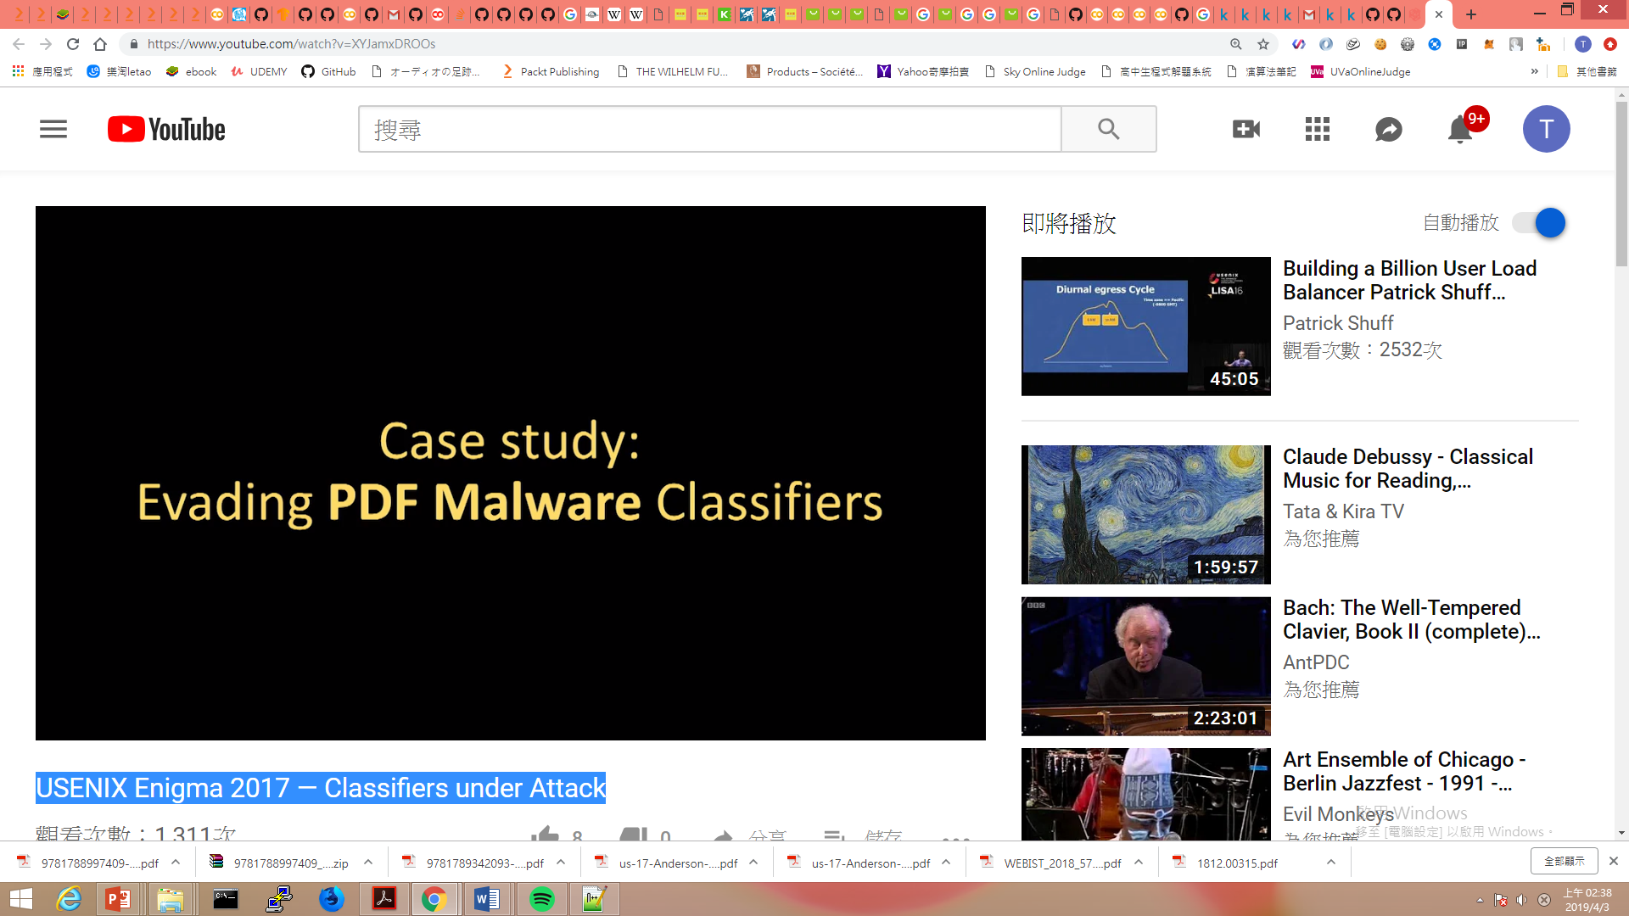
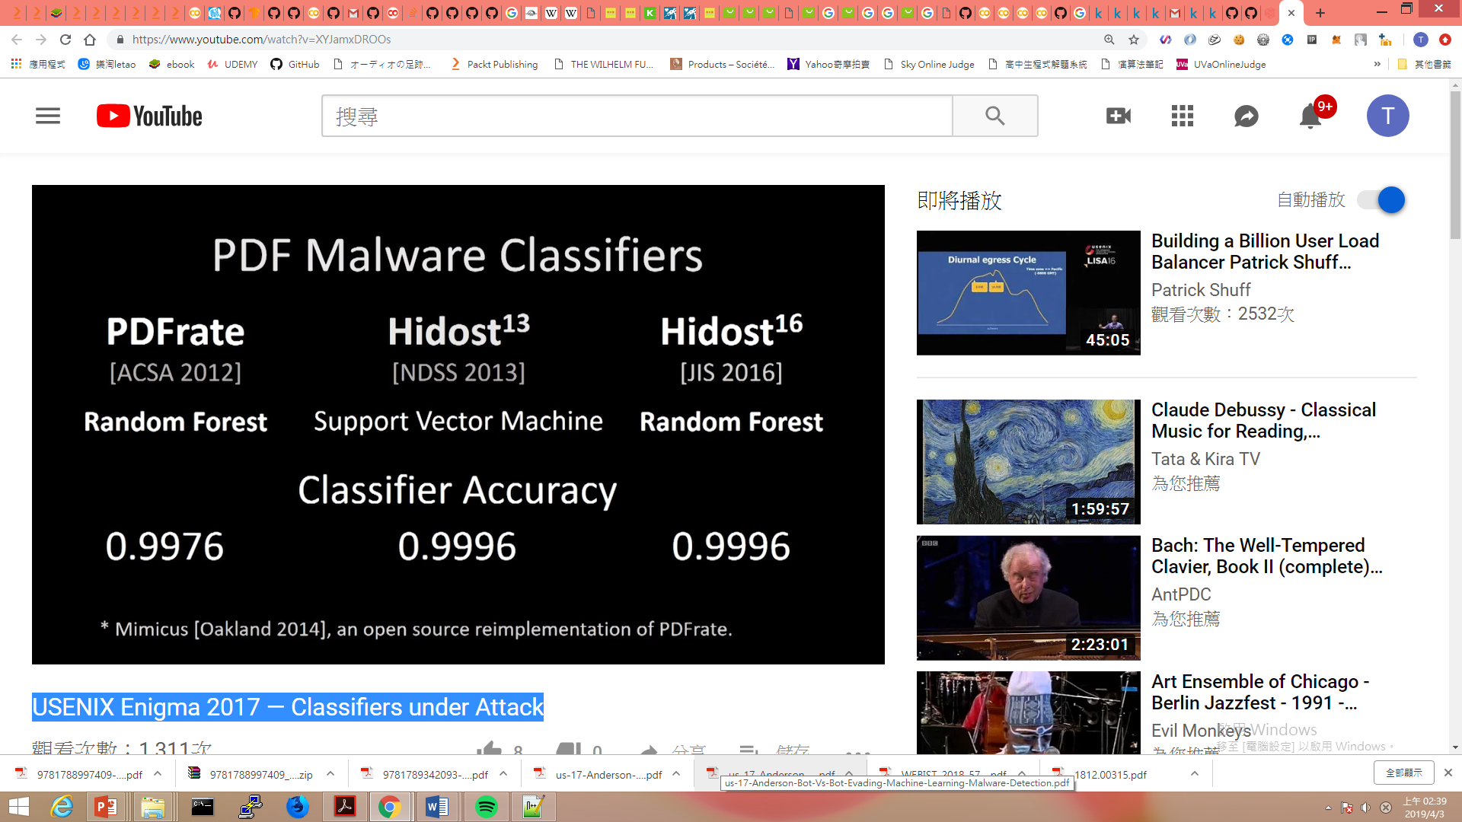
推薦學習:YOUTUBE USENIX Enigma 2017 — Classifiers under Attack https://www.youtube.com/watch?v=XYJamxDROOs

Slide 68
AI 駭客攻防戰2019

